Slide 1
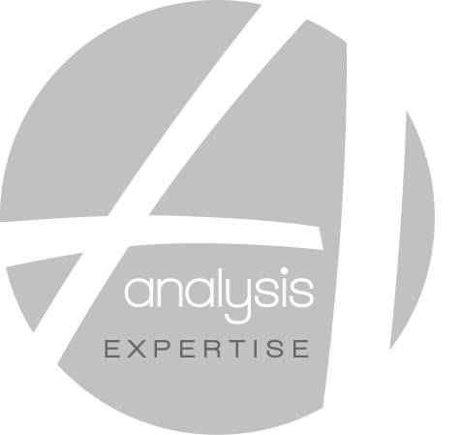
Salivary test for alcohol and drugs screening
Analysis Laboratories

Slide 2
Table Of Content
Executive summary
Salivary test objectives
Salivary test presentation
Our salivary test within your company
The company : Analysis Laboratories

Slide 3
Executive Summary
Inspired by a recent update in the French Law which allows employers to test the drug consumption of their employees, our company -Analysis Laboratories- has developed powerful salivary tests. Easy to use and requiring no medical expert, our salivary tests aim at protecting employers from unsafety. They also prevent employees from work accidents.
Our salivary tests have been designed to be used at the workplace : in case of emergency or for routine safety checks. Using our tests only requires 6 simple steps to collect employees saliva. The saliva samples are shipped to our laboratories in France and the results are delivered to you 24 hours after we receive the samples. Our method efficiently discovers alcohol and drug consumers. By using a specific code, the identity of your employees remains undisclosed to our teams.
We offer three different packages to meet your company’s needs and size. From the reshaping of your security policy to a unique drug screening, Analysis Laboratories can help you to improve your company’s safety.

Slide 4
Table Of Content
Executive summary
Salivary test objectives
Salivary test presentation
Our salivary test within your company
The company : Analysis Laboratories

Slide 5
Our salivary test helps your company attain high level of security and reduce associated costs
1
DETECT EFFICIENTLY DRUG CONSUMPTION
3
REDUCE COST OF WORKPLACE ACCIDENTS
Our salivary test identifies drugs and alcohol consumers even with low levels of illegal substances within the saliva sample.
Results are validated by several quality tests operated by an automat and approved by biologist experts*
Our salivary test reduces your risk-associated costs through three powerful leverages
Reduction of absenteeism costs by preventing illnesses
Decrease of insurance costs by using best practices
Decrease of work accidents compensations
2
ENHANCE SECURITY WITHIN THE COMPANY
4
PREVENT STAFF FROM RISKY BEHAVIORS
Our salivary test enables employers to improve their employee’s health and reduce organization’s risk by decreasing illegal drugs consumption at the workplace. 95% of our interventions have detected drug consumers within organisations
Our salivary test discourages consumption at the workplace and limits the dangerous behaviors triggered by narcotics and alcohol.
100%** of accompanied clients have noticed a significant change of the employees behavior after the test
* : 10% of our employees are experts and own an accredited French Diploma
** : According to 2017-2018 testimonies

Slide 6
Our salivary test aims at both protecting employer and employees
SUPPORTING STABILITY OF BUSINESS
SETTING UP RANDOM SALIVARY TESTS
PROMOTING HEALTHIER WORKFORCE
Deter consumers from taking illegal substances
Lower employees turnover
1
Reduce absenteisme and therefore increase productivity
Trust-based relationship between management and staff
2
Guarantee of better value delivered to final client
Improves motivation by decreasing work accidents
3

Slide 7
95%
Of the executives we accompany had misconceptions about the risk their employees make the company bear*
* : According to the feedback of our clients in 2017

Slide 8
Table Of Content
Executive summary
Salivary test objectives
Salivary test presentation
Our salivary test within your company
The company : Analysis Laboratories

Slide 9
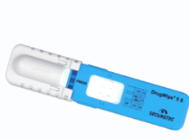
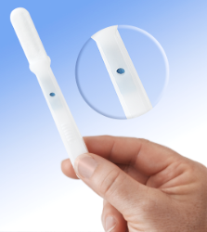
We have developed two salivary tests to fit both emergency and routine safety check
Emergency test : dispelling doubt when facing an employee unusual behaviour
Safety check test : Organising random tests among employees
Result available immediately with 90% of accuracy after 8 min. If the bottom line is red, the test is positive. You can then send the test to Analysis for 100% accuracy
Result available after Analysis expertise (100% accuracy) : a simple 6-step process is run by our laboratories
Efficient from very low levels of illegal substances
Efficient from very low levels of illegal substances
Immediate result
Confidential and 100% accurate
90% accurate
Wider range of drugs tested
Then the test is sent for a complementary analysis
Additional analysis can be run on request
The emergency test is offered when you order safety check tests

Slide 10
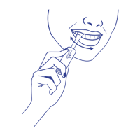
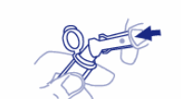
Safety check test : a 6-step process which does not require any medical expertise at the workplace
1
2
3
Insert the test within the mouth between the chick and the gum, remove it only when the light becomes blue
Remove the cotton stamp and insert it within the tube used for shipment
Close the tube used for shipment and seal it
4
5
6
Protect the tubes by putting them inside the provided envelope
Fill in the form with the numbers of the samples and the corresponding names*
Post the envelop, this will be directly shipped to our laboratory
Samples are then anonymously analysed and results are delivered within 24h**
* : Your company is the only party who keeps a record of the screened employees. Employee’s privacy is therefore respected
** : 24 h after the reception of the samples

Slide 11
Our tests have 4 different usages that will strengthen your company’s safety
1
Dispel doubts when facing an employee’s unusual behaviour
2
Organise random drug screenings among employees to deter drug consumption within the organization
3
Run the illegal substances test after work accidents
4
Run the drug screening mentioned in the employee’s job contract (if any)

Slide 12
Table Of Content
Executive summary
Salivary test objectives
Salivary test presentation
Our salivary test within your company
The company : Analysis Laboratories

Slide 13
Our salivary test prevents your company from the four main issues caused by drugs and alcohol consumption
Decrease workplace accidents
Reduce insurance costs
Lower employees turnover
Enhance brand image
Drugs and alcohol decrease employee’s ability to concentrate, to memorise and to act logically
It increases risky behaviors and violence within the workplace
In France, 20 to 30%* of workplace accidents are due to these consumptions
Annual insurance fees increase when workplace accidents has happened within the company
Implementing our test tends to reduce insurance fees by reducing the overall risk of the company
Drug and alcohol consumption lead to chronic illness such as cardiovascular diseases, brain damages and cancers
Employees with alcohol problems are 2.7 times more likely than other employees to have injury-related absences**
Cerebral and behavioural dysfunctions induced by drug prevent employees from doing their job correctly
This reduces the quality of the services delivered to the final customer
An unreliable workforce tarnishes your brand image
* : According to INSERM 2017 figures
** : According to NCADD 2017 figures

Slide 14
24% of US
workers
10-20% of work accidents in Europe
Acknowledge having illegally drank during workday over the last year*
Are caused by alcohol consumption at the workplace**
* : According to NCADD 2017 figures
** : According to INSERM 2017 figures

Slide 15
Beyond offering a salivary test, we help your company enhancing its security policy
BUILD AN EFFICIENT DRUG TESTING POLICY
Our 4 dimensions vision
ANSWER TO YOUR HEALTH AND SAFETY QUESTIONS
DESIGN A TAILORED DRUG & ALCOHOL TESTING ROADMAP
SET UP TOOLS TO MEASURE COMPANY’S SAFETY ENHANCEMENT

Slide 16
Our clients have tackled the same safety issues you are currently facing
Number of entities accompanied per type
Our 6-step process is tailored for any company and has enabled our group to reach clients from CAC 40 listed companies to SMEs and Tribunals. We are proud to help companies such as one of the biggest French car manufacturers, or one of the French leaders of fashion industry*
Used to help any size-type company to tackle its security issues, our team is ready to accompany yours
10 | CAC 40 listed companies
40+ | SMEs
50+ | Legal entities : Tribunals
10 | International entities
* : Names are not disclosed due to confidentiality clause

Slide 17
Table Of Content
Executive summary
Salivary test objectives
Salivary test presentation
Our salivary test within your company
The company : Analysis Laboratories

Slide 18
Key Figures
Located in the East of France, our company has grown through several acquisitions over the past eleven years. Our dedicated team is composed of healthcare professionals, trained to the most recent biology technologies
85%results delivered
130 employees
1400+patients / day
the same day
Rapidity is key for medical analysis and therefore 85% of the performed tests are delivered on the same day*
Our company is an SME composed of 130 high skilled employees dedicated to the rapid delivery of analysis results
More than 1400 patients everyday trust our services for their different health analysis
* : The remaining 15% are delivered within 24 hours

Slide 19
Our group has grown rapidly and performs diagnostics from its 6 sites located in the East of France
CREATION OF ANALYSIS LABORATORIES
ACQUISITION OF 3 NEW LABORATORIES
OPENING OF OUR 6th LOCATION
CREATION OF NEW HEADQUARTERS
CREATION OF ANALYSIS EXPERTISE
Our group Analysis Laboratories was created in 2000 in Epinal, after the merger of two existing entities: GONAND-LEFAURE Laboratory and DENIS-CULARD Laboratory
Three new laboratories located in the nearby of Epinal are acquired and integrated to the group. This increased capacity enables the group to gain large market shares
Due to an increasing demand, the group opens a 6th site in Thaon-les-vosges. This 6th location enables the group to help everyday more than 1400 patients to answer to their health questions
2002
2010
2000
2007
2017
The analysis we perform require rapid delivery of results. A new technical center is therefore implemented in the center of Epinal City. This center is an enabler for future growth
CODGENE company is acquired and enables the group to deliver new services to legal entities

Slide 20
Our unparalleled quality of services has been chosen by 400+ International companies and tribunals
Footprint in France
Footprint overseas
Martinique
Guadeloupe
We are used to international shipments and therefore able to offer services across Africa

Slide 21
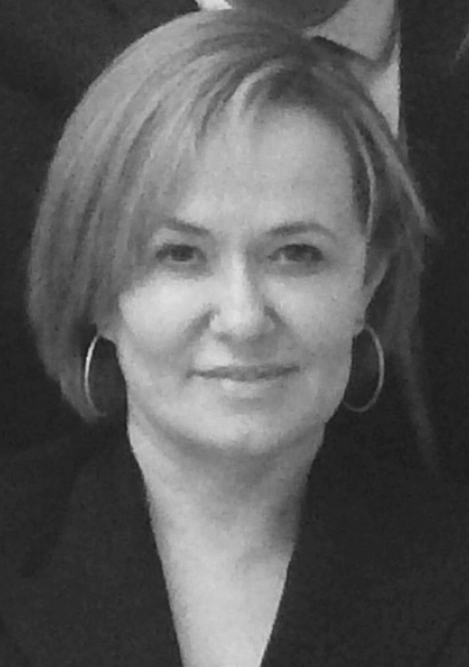
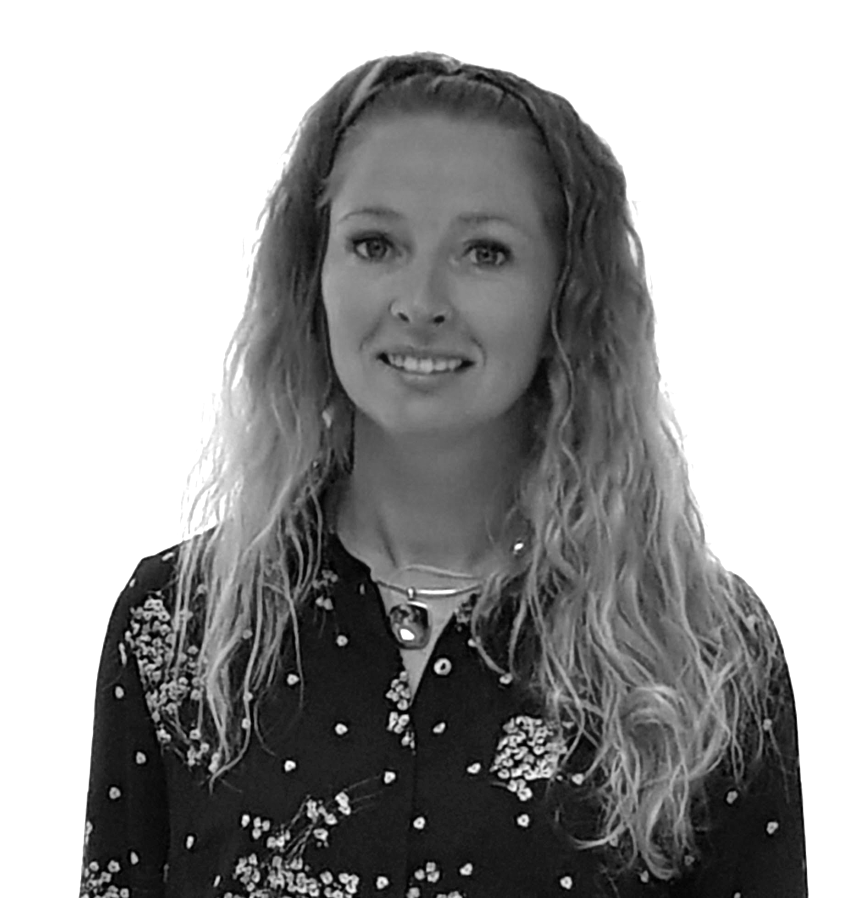
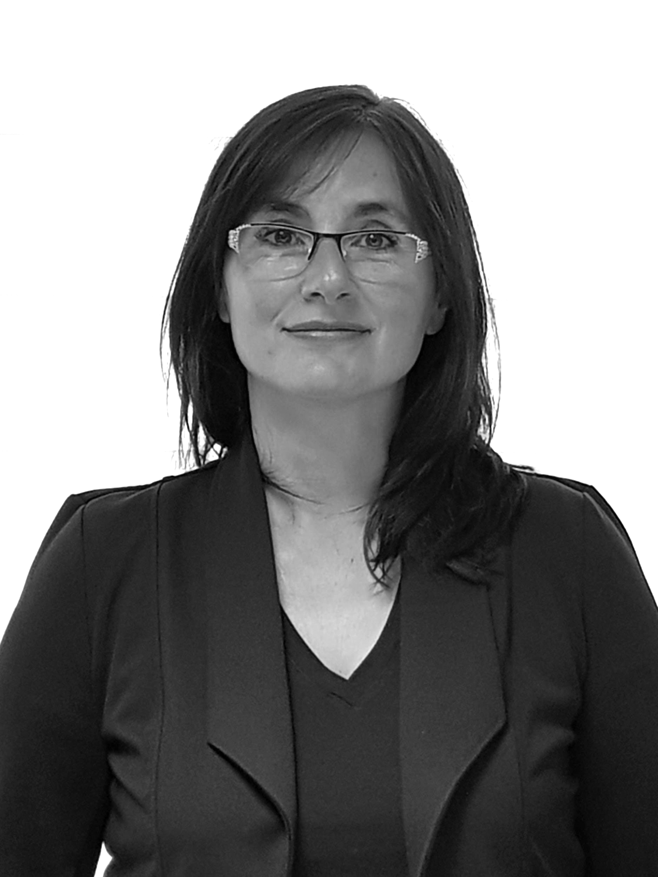
Your key contacts
Our team will help your organization to seamlessly integrate our salivary tests into
your workflow
You can also contact Analysis Laboratories directly via email or telephone 24/7
Address : 1 rue Léo Valentin 88000 EPINAL - FRANCE
Phone : + 33 3 29 30 30 10
Email : contact-expertise@analysis.fr
Co-Managing Partner, Biologist
Toxicology and genetics expert
CFO
Co-Managing Partner, Biologist
Toxicology and genetics expert
Dr. Christophe Petit
Dr. Véronique Petit
Commercial teams coordinator
CFO
Business Developer
Ingrid Charton
Brigitte Djitli

Slide 22
